Slide 1

Capital Budgeting
(Unit III)
Dr.M.Velavan
Faculty
School of Management
SASTRA Deemed University
Thanjavur – 613 401

Slide 2
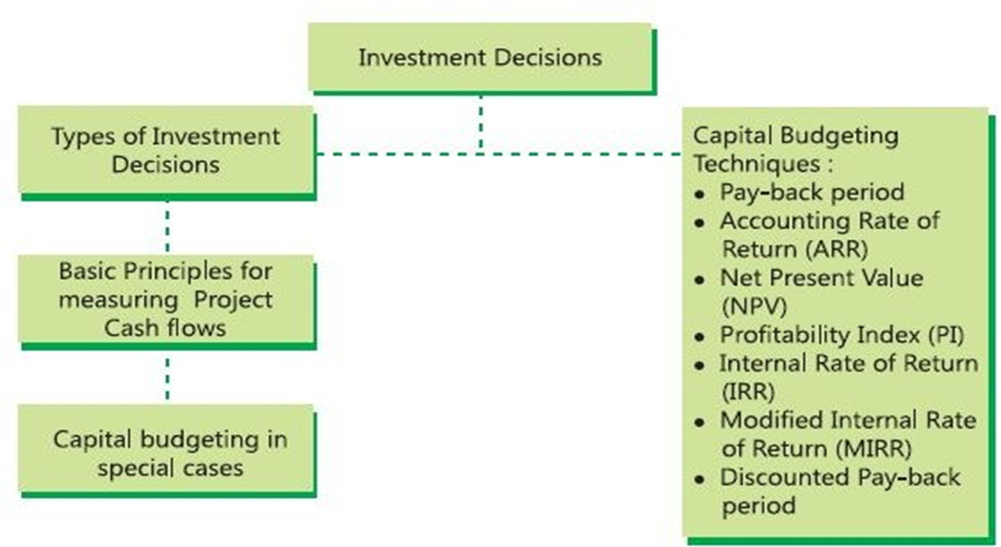
Overview:

Slide 3
1. Introduction:
One of the important aspects of Financial Management is proper decision making in respect of investment of funds. Successful operation of any business depends upon the investment of resources in such a way as to bring in benefits or best possible returns from any investment. An investment can be simply defined as an expenditure in cash or its equivalent during one or more time periods in anticipation of enjoying a net inflow of cash or its equivalent in some future time period or periods.
An appraisal of investment proposals is necessary to ensure that the investment of resources will bring in desired benefits in future. If the financial resources were in abundance, it would be possible to accept several investment proposals which satisfy the norms of approval or acceptability. Since resources are limited a choice has to be made among the various investment proposals by evaluating their comparative merit.

Slide 4
It is apparent that some techniques should be followed for making appraisal of investment proposals. Capital Budgeting is one of the appraising techniques of investment decisions.
Capital Budgeting is defined as the firm‘s decision to invest its current funds most efficiently in long term activities in anticipation of an expected flow of future benefits over a series of years. It should be remembered that the investment proposal is common both for fixed assets and current assets.
Investment decision is concerned with optimum utilization of fund to maximize the wealth of the organization.

Slide 5
Capital Budgeting involves:
Identification of investment projects that are strategic to business’ overall objectives;
Estimating and evaluating post-tax incremental cash flows for each of the investment proposals; and
Selection of an investment proposal that maximizes the return to the investors.

Slide 6
2. Definitions:
Charles. T. Horngreen defined capital budgeting as Long - term planning for making and financing proposed capital out lay.
According to Keller and Ferrara, Capital Budgeting represents the plans for the appropriation and expenditure for fixed asset during the budget period.
Robert N. Anthony defined as Capital Budget is essentially a list of what management believes to be worthwhile projects for the acquisition of new capital assets together with the estimated cost of each product.

Slide 7
3. Purpose of Capital Budgeting:
The selection of the most profitable project for capital investment is the key function of the Financial Manager. The decisions taken by the management in this area have affected the operations of the firm for many years.
Capital budgeting decisions may be generally needed for the following purposes:
a) Expansion;
b) Replacement;
c) Diversification;
d) Buy or lease and
e) Research and Development.

Slide 8
Expansion:
The firm requires additional funds to invest in fixed assets when it intends to expand the production facilities in view of the increase in demand for their product in near future. Accordingly the current assets will increase. In case of expansion the existing infrastructure – like plant, machinery and other fixed assets is inadequate, to carry out the increased production volume. Thus the firm needs funds for such project. This will include not only expenditure on fixed assets (infrastructure) but also an increase in working capital (current assets).

Slide 9
b) Replacement:
The machines and equipment used in production may either wear out or may be rendered obsolete due to new technology. The productive capacity and competitive ability of the firm may be adversely affected. The firm needs funds or modernisation of a certain machines or for renovation of the entire plant etc., to make them more efficient and productive. Modernization and renovation will be a substitute for total replacement, where renovation or modernization is not desirable or feasible, funds will be needed for replacement.
c) Diversification:
If the management of the firm decided to diversify its production into other lines by adding a new line to its original line, the process of diversification would require large funds for long-term investment. For example ITC and Philips company for their diversification.

Slide 10
d) Buy or Lease:
This is a most important decision area in Financial Management whether the firm acquire the desired equipment and building on lease or buy it. If the asset is acquired on lease, there have to be made a series of annual or monthly rental payments. If the asset is purchased, there will be a large initial commitment of funds, but not further payments. The decision – making area is which course of action will be better to follow? The costs and benefits of the two alternative methods should be matched and compared to arrive at a conclusion.
e) Research and Development:
The existing production and operations can be improved by the application of new and more sophisticated production and operations management techniques. New technology can be borrowed or developed in the laboratories. There is a greater need of funds for continuous research and development of new technology for future benefits or returns from such investments.

Slide 11
Capital Budgeting decisions are considered important for a variety of reasons. Some of them are the following:
1) Crucial decisions:
Capital budgeting decisions are crucial, affecting all the departments of the firm. So the capital budgeting decisions should be taken very carefully.
2) Long-run decisions:
The implications of capital budgeting decisions extend to a longer period in the future. The consequences of a wrong decision will be disastrous for the survival of the firm.
3) Large amount of funds:
Capital budgeting decisions involve spending large amount of funds. As such proper care should be exercised to see that these funds are invested in productive purchases.

Slide 12
4) Rigid:
Capital budgeting decision cannot be altered easily to suit the purpose. Because of this reason, when once funds are committed in a project, they are to be continued till the end, loss or profit no matter.
4. Process of Capital Budgeting:
The major steps in the capital budgeting process are given below:
They are:
a) Generation of project;
b) Evaluation of the project;
c) Selection of the project and
d) Execution of the project.
The capital budgeting process may include a few more steps. As each step is significant they are usually taken by top management.

Slide 13
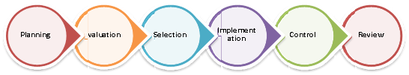

Slide 14
a) Generation of Project:
Depending upon the nature of the firm, investment proposals can emanate from a variety of sources. Projects may be classified into five categories.
(i) New products or expansion of existing products.
(ii) Replacement of equipment or buildings.
(iii) Research and development.
(iv) Exploration.
(v) Others like acquisition of a pollution control device etc.
Investment proposals should be generated for the productive employment of firm‘s funds. However, a systematic procedure must be evolved for generating profitable proposals to keep the firm healthy

Slide 15
b) Evaluation of the project:
The evaluation of the project may be done in two steps. First the costs and benefits of the project are estimated in terms of cash flows and secondly the desirability of the project is judged by an appropriate criterion. It is important that the project must be evaluated without any prejudice on the part of the individual. While selecting a criterion to judge the desirability of the project, due consideration must be given to the market value of the firm.
c) Selection of the project:
After evaluation of the project, the project with highest return should be selected. There is no hard and fast rule set for the purpose of selecting a project from many alternative projects. Normally the projects are screened at various levels. However, the final selection of the project vests with the top level management.

Slide 16
d) Execution of project:
After selection of a project, the next step in capital budgeting process is to implement the project. Thus the funds are appropriated for capital expenditures. The funds are spent in accordance with appropriations made in the capital budget funds for the purpose of project execution should be spent only after seeking format permission for the controller. The follow – up comparison of actual performance with original estimates ensure better control. Thus the top management should follow the above procedure before taking a capital expenditure decision.

Slide 17
5. Types of Capital Investment/Budgeting Decisions:
There are many ways to classify capital budgeting decisions. Generally, capital investment decisions are classified in two ways. One way is to classify them based on the firm’s existence. Another way is to classify them based on the decision situation.

Slide 18
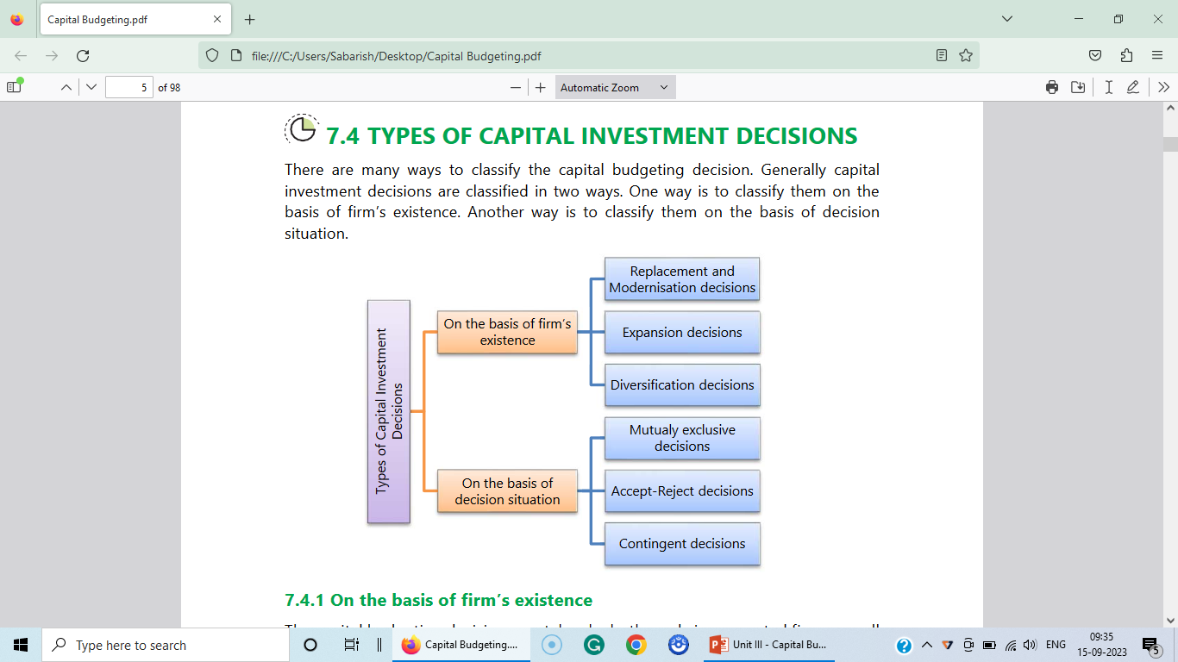

Slide 19
6. Investment Criterion-Methods of Appraisal:
The capital budgeting appraisal methods or techniques for evaluation of investment proposals will help the company to decide the desirability of an investment proposal, depending upon their relative income generating capacity and rank them in order if their desirability. These methods provide the company a set of normal method should enable to measure the real worth of the investment proposal. The appraisal methods should posses several good characteristics, which are mentioned as under.

Slide 20
Characteristics of a Sound Appraisal Method:
(i) It should help the company to rank the investment proposals in order of their desirability.
(ii) It should provide a technique for distinguishing between an acceptable and nonacceptable project.
(iii) It should provide a criteria to solve the problem of choosing among alternative projects.
(iv) It should recognize the importance of time value of money i.e. bigger benefits are preferable to smaller ones and early benefits are preferable to later benefits.
(v) It should provide the criteria for the selection of investment proposals. (vi) It should take into account the pattern of cash flows.

Slide 21
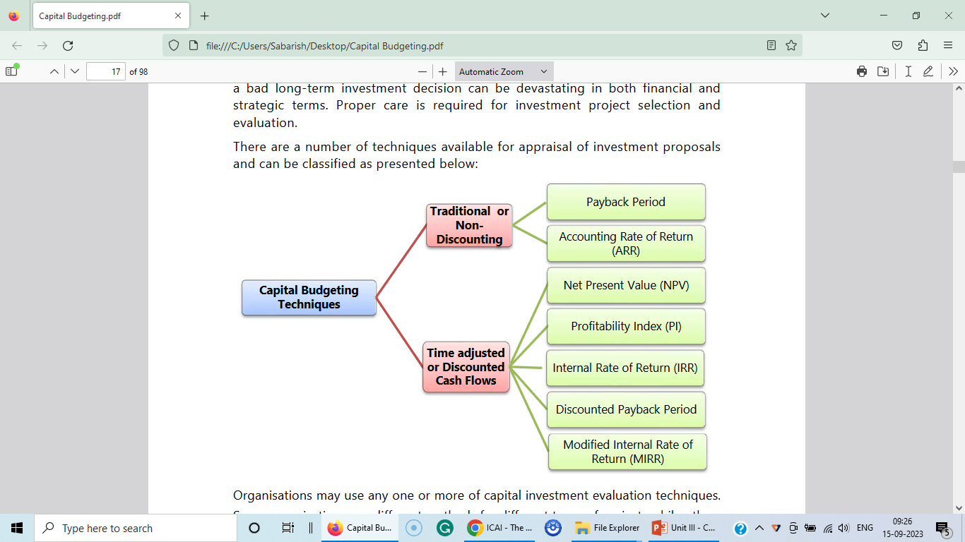
7. Types of Capital Budgeting techniques :
There are several techniques available for the appraisal of investment proposals and can be classified as presented below:

Slide 22
A) Traditional Methods:
These methods are based on the principles to determine the desirability of an investment project on the basis of its useful life and expected returns. These methods depend upon the accounting information available from the books of accounts of the company. These will not take into account the concept of time value of money which is a signification factors to desirability of a project in terms of present value.
1. Pay-back Period:
It is the most popular and widely recognized traditional methods of evaluating the investment proposals. It can be defined as ―the number of years to recover the original capital invested in a project.
According to Weston and Brigham, ―the payback period is the number of years it takes for the firm to recover its original investment by net returns before depreciation, but after taxes:

Slide 23
When cash flows are uniform/Uniform Cash Flows:
If the proposed project‘s cash inflows are uniform the following formula can be used to calculate the payback period.
Payback period = Initial Investment/Annual Cash inflows
Annual Cash inflow = Profit after tax plus depreciation (CFAT)
b) When cash flows are not uniform/Non-Uniform Cash Flows:
When the project‘s cash inflows are not uniform, but vary from year to year pay back period is calculated by the process of cumulating cash inflows till the time when cumulative cash flows become equal to the original investment outlay.

Slide 24
The payback period can be used as an accept or reject criterion as well as a method of ranking projects. The payback period is the number of years to recover the investment made in a project. If the payback period calculated for a project is less than the maximum payback period set-up by the company, it can be accepted.
As a ranking method it gives the highest rank to a project which has the lowest payback period, and the lowest rank to a project with the highest payback period. Whenever a company faces the problem of choosing among two or more mutually exclusive projects, it can select a project on the basis of payback period, which has shorter period than the other projects.

Slide 25
Merits:
The following are the merits of the payback period method:
(i) Easy to calculate: It is one of the easiest methods of evaluating the investment projects. It is simple to understand and easy to compute.
(ii) Knowledge: The knowledge of payback period is useful in decision-making, the shorter the period better the project.
(iii) Protection from loss due to obsolescence: This method is very suitable to such industries where mechanical and technical changes are routine practice and hence, shorter payback period practice avoids such losses.
(iv) Easily availability of information: It can be computed on the basis of accounting information, what is available from the books.

Slide 26
Demerits:
However, the payback period method has certain demerits:
(i) Failure in taking cash flows after payback period: This methods is not taking into account the cash flows received by the company after the payback period.
(ii) Not considering the time value of money: It does not take into account the time value of money.
(iii) Non-considering of interest factor: It does not take into account the interest factor involved in the capital outlay.
(iv) Maximisation of market value not possible: It is not consistent with the objective of maximizing the market value of share.
(v) Failure in taking magnitude and timing of cash inflows: It fails to consider the pattern of cash inflows i.e. the magnitude and timing of cash inflows.

Slide 27
Solved problems:
P1. A project costs Rs. 2,50,000 and yields an annual cash inflow of Rs. 50,000 for 7 years. Calculate it’s Pay Back Period.
Solution:
PBP = Initial Investment/Annual cash inflows
= Rs. 2,50,000/Rs. 50,000
= 5 years.

Slide 28
P2. A project cost Rs. 5,00,000 and yields profit of Rs. 1,00,000 after writing off depreciation of Rs. 25,000 per annum. Calculate Pay Back Period.
Solution:
Pay Back Period = Initial Investment/Annual Cash flows
Annual Cash flows (CFAT) = Profit after tax + Depreciation
= Rs. 1,00,000 + Rs. 25,000
= Rs. 1,25,000
Pay Back Period = Rs. 5,00,000/Rs. 1,25,000
= 4 years

Slide 29
P3. A project has an initial investment of Rs. 2,00,000. It will produce cash flows after tax Rs. 50,000 per annum for six years. Compute the Pay Back period for the project.
Solution:
Computation of Pay Back Period:
Pay back period = Initial Investment/Annual cash inflow
= Rs. 2,00,000/Rs. 50,000
= 4 years

Slide 30
P4. Project A has an initial investment of Rs. 5,00,000. It’s cash inflows for 5 years are Rs. 1,50,000, Rs. 1,80,000, Rs. 1,50,000, Rs. 1,32,000 and Rs. 1,20,000. Calculate the Pay back period.
Solution:
Statement showing Cumulative cash inflows
Year | Annual Cash inflows Rs. | Cumulative annual cash inflows Rs.
1. | 1,50,000 | 1,50,000
2. | 1,80,000 | 3,30,000
3. | 1,50,000 | 4,80,000
4. |  | 6,12,000
5. | 1,20,000 | 7,32,000
1,32,000

Slide 31
Pay back period = 3 years + {[Rs. 20,000/Rs. 1,32,000] ×12}
= 3 years + 2 months
= 3.2 years

Slide 32
1.1 Payback Reciprocal:
As the name indicates, it is the reciprocal of the payback period. A major drawback of the payback period method of capital budgeting is that it does not indicate any cut-off period for the purpose of investment decisions. It is, however, argued that the reciprocal of the payback would be a close approximation of the Internal Rate of Return (later discussed in detail) if the life of the project is at least twice the payback period and the project generates an equal amount of the annual cash inflows. In practice, the payback reciprocal is a helpful tool for quick estimation of the rate of return of a project provided its life is at least twice the payback period.

Slide 33
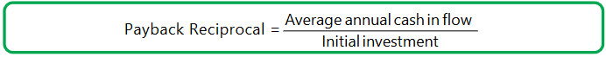
The payback reciprocal can be calculated as follows:

Slide 34
Example:
Suppose a project requires an initial investment of Rs. 20,000 and it would give an annual cash inflow of Rs. 4,000. The useful life of the project is estimated to be 10 years.
In this example, payback reciprocal = [Rs. 4,000/Rs. 20,000]100 = 20%
The above payback reciprocal provides a reasonable approximation of the
internal rate of return, i.e. 20%

Slide 35
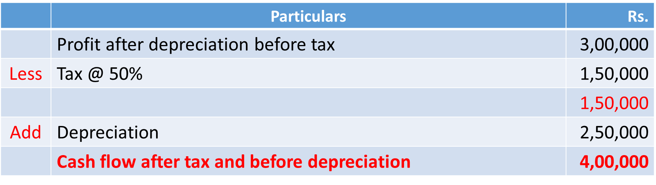
P5. A project costs Rs. 20,00,000 and yields annually a profit of Rs. 3,00,000 after depreciation at 12.5% but before tax at 50%. Calculate pay back period.
Solution: Statement showing CFAT
Pay back period = Initial Investment/CFAT
= Rs.20,00,000/Rs.4,00,000
= 5 years

Slide 36
P6. A company has to choose one of the following two mutually exclusive projects. Investment required for each project is Rs. 1,50,000. Both the projects have to be depreciated on straight line basis. The tax rate is 50%.
Year | Profit before depreciation
 | Project X Rs. | Project Y Rs.
1 | 42,000 | 42,000
2 | 48,000 | 45,000
3 | 70,000 | 40,000
4 | 70,000 | 50,000
5 | 20,000 | 1,00,000

Slide 37
Solution:
Project X Statement showing CIFAT
Pay back period = 3 years + {[Rs. 25,000/Rs. 50,000] × 12}
= 3.6 years
Year | Profit before dep and tax Rs. | Less: Dep (1,50,000/5) Rs. | Profit before tax Rs. | Less: Tax @50% Rs. | PAT Rs. | Add: Dep Rs. | CIF Rs. | Cumulative CCIF Rs.
1 | 42,000 | 30,000 | 12,000 | 6,000 | 6,000 | 30,000 | 36,000 | 36,000
2 | 48,000 | 30,000 | 18,000 | 9,000 | 9,000 | 30,000 | 39,000 | 75,000
3 | 70,000 | 30,000 | 40,000 | 20,000 | 20,000 | 30,000 | 50,000 | 1,25,000
4 | 70,000 | 30,000 | 40,000 | 20,000 | 20,000 | 30,000 | 50,000 | 1,75,000
5 | 20,000 | 30,000 | (10,000) | Nil | (10,000) | 30,000 | 20,000 | 1,95,000

Slide 38
Project Y: Statement showing CIFAT
Pay back period = 4 years + {[Rs.1,500/Rs. 65,000] × 365}
= 4 years and 8 days or 4 years and 0.277 months
Year | Profit before dep and tax Rs. | Less: Dep (1,50,000/5) Rs. | Profit before tax Rs. | Less: Tax @50% Rs. | PAT Rs. | Add: Dep Rs. | CIF Rs. | Cumulative CCIF Rs.
1 | 42,000 | 30,000 | 12,000 | 6,000 | 6,000 | 30,000 | 36,000 | 36,000
2 | 45,000 | 30,000 | 15,000 | 7,500 | 7,500 | 30,000 | 37,500 | 73,500
3 | 40,000 | 30,000 | 10,000 | 5,000 | 5,000 | 30,000 | 35,000 | 1,08,500
4 | 50,000 | 30,000 | 20,000 | 10,000 | 10,000 | 30,000 | 40,000 | 1,48,500
5 | 1,00,000 | 30,000 | 70,000 | 35,000 | 35,000 | 30,000 | 65,000 | 2,13,500

Slide 39
P7. It is proposed to introduce a new machine to increase the production capacity of Department X. Two Machines are available Type “A” and Type “B”. The following information is available:
Particulars | A (Rs.) | B (Rs.)
Cost of Machine | 3,50,000 | 6,30,000
Estimated Life (Years) | 7 | 10
Estimated savings in scrap p.a. | 20,000 | 32,000
Additional cost of indirect materials p.a. | 10,000 | 16,000
Estimated savings in wages:
Employees not required | 15 | 20
Wages per employees per annum | 10,000 | 16,000
Additional cost of maintenance p.a. | 7,200 | 12,000
Additional cost of supervision p.a. | 24,000 | 36,000

Slide 40
The rate of taxation can be regarded as 50% of profits. Which machine can be recommended for purchase?
Solution:
Working Note:
a) Computation of Amount of Depreciation:
Amount of depreciation = Cost of machine/Estimated life
Machine A = Rs. 3,50,000/7 years
= Rs. 50,000
Machine B = Rs. 6,30,000/10 years
= Rs. 63,000

Slide 41
Profitability Statement
Particulars |  | Machine A Rs. | Machine B Rs.
 | Estimated savings per year:
 | Scrap | 20,000 | 32,000
 | Wages (15×Rs. 10,000) (20×Rs. 16,000) | 1,50,000 | 3,20,000
 | Total savings (A) | 1,70,000 | 3,52,000
Less | Estimated additional cost per year:
 | Indirect materials | 10,000 | 16,000
 | Cost of maintenance | 7,200 | 12,000
 | Cost of supervision | 24,000 | 36,000
 | Total additional costs (B) | 41,200 | 64,000

Slide 42
 | Profit before depreciation and Tax (A-B) | 1,28,800 | 2,88,000
Less | Depreciation | 50,000 | 63,000
 | Profit before tax | 78,800 | 2,25,000
Less | Tax @ 50% | 39,400 | 1,12,500
 | Profit after tax | 39,400 | 1,12,500
Add | Depreciation | 50,000 | 63,000
 | Cash inflows flows after tax (CFAT) | 89,400 | 1,75,500
 | Pay back period = Cost of Machine/CFAT | Rs. 3,50,000/ Rs. 89,400 | Rs. 6,30,000/ Rs. 1,75,500
 |  | 3 years and 9 months | 3 years and 6 months

Slide 43
Recommendation:
The payback period of Machine B is lesser than Machine A. Hence, it is recommended to purchase Machine B.

Slide 44
2. Accounting or Average Rate of Return (ARR):
This technique uses the accounting information revealed by the financial statements to measure the profitability of an investment proposal. It can be determined by dividing the average income after taxes by the average investment.
According to Soloman, Accounting Rate of Return can be calculated as the ratio, of average net income to the initial investment.
On the basis of this method, the company can select all those projects whose ARR is higher than the minimum rate established by the company. It can reject the projects with an ARR lower than the expected rate of return.

Slide 45
This method also helps the management to rank the proposal on the basis of ARR.
ARR = Average Net Income/Original Investment Or
ARR = Average Net Income/Average Investment
Note:
Average net income = Profit after depreciation and tax
Average Investment = ½ (Initial Investment – Salvage Value) + Salvage Value
Acceptance Rule:
The project which gives the highest rate of return over the minimum required rate of return is acceptable

Slide 46
Merits:
The following are the merits of the ARR method:
(i) It is very simple to understand and calculate;
(ii) It can be readily computed with the help of the available accounting data;
(iii) It uses the entire stream of earnings to calculate the ARR.
Demerits:
This method has the following demerits:
It is not based on cash flows generated by a project;
(ii) This method does not consider the objective of wealth maximization;
(iii) It ignores the length of the project’s useful life;
(iv) If does not take into account the fact that the profile can be re-invested;
(v) It ignores the time value of money.

Slide 47
P8. Compute ARR from the following data:
Cost of asset = Rs. 4,00,000
Estimated life = 5 years
Cash flow after tax before depreciation (CFAT) = Rs. 1,72,000
Solution: Calculation of profit after depreciation and tax
ARR = [Profit after dep. and tax/Original investment]×100
= [Rs.92,000/Rs. 4,00,000]×100
ARR = 23%
 | Particulars | Rs.
 | Cash flow after tax (CFAT) | 1,72,000
Less | Depreciation ( Rs. 4,00,000/5) | 80,000
 | Profit after depreciation and tax | 92,000

Slide 48
P9. Project K requires an investment of Rs. 20,00,000 and yields profits after tax and depreciation as follows:
At the end of 5th year, the plant can be sold for Rs. 1,60,000. You are required to calculate ARR.
Year | Profits after tax and depreciation Rs.
1. | 1,00,000
2. | 1,50,000
3. | 2,50,000
4. | 2,60,000
5. | 1,60,000

Slide 49
Solution:
Calculation of Average investment
Year | Profits after tax and depreciation Rs.
1. | 1,00,000
2. | 1,50,000
3. | 2,50,000
4. | 2,60,000
5. | 1,60,000
Total profit | 9,20,000
Average profit [Total profit/No.of years] [Rs. 9,20,000/5] | 1,84,000

Slide 50
Average investment = ½ [Original investment – Scrap value]+ Scrap Value
= ½ [Rs. 20,00,000 – Rs. 1,60,000] +1,60,000
= Rs. 9,20,000 + 1,60,000
Accounting Rate of Return [ARR] = [Rs. 1,84,000/Rs. 10,80,000]×100
= 17.03%

Slide 51
P10. A company has two alternative proposals. The details are as follows:
Compute the profitability of the proposals under the return on investment method. Ignore taxation.
Particulars | Proposal I | Proposal II
 | Automatic Machine | Ordinary Machine
Cost of the machine | Rs. 2,20,000 | Rs. 60,000
Estimated life | 5½ years | 8 years
Estimated sales p.a. | Rs. 1,50,000 | Rs. 1,50,000
Costs : Material | Rs. 50,000 | Rs. 50,000
Labour | Rs. 12,000 | Rs. 60,000
Variable Overheads | Rs. 24,000 | Rs. 20,000

Slide 52
Working Note:
1. Calculation of depreciation:
Dep = Original cost/Estimated life
Automatic machine = Rs. 2,20,000 ÷ 5½ = Rs. 40,000
Ordinary machine = Rs. 60,000 ÷ 8 = Rs. 7,500

Slide 53
Solution: Profitability Statement
 | Particulars | Automatic Machine | Ordinary Machine
 | Cost of the machine | Rs. 2,20,000 | Rs. 60,000
 | Life of the machine | 5½ years | 8 years
 |  | Rs. | Rs.
 | Estimated Sales (A) | 1,50,000 | 1,50,000
Less | Estimated Cost
 | Material | 50,000 | 50,000
 | Labour | 12,000 | 60,000
 | Variable overheads | 24,000 | 20,000
 | Depreciation (As per note:1) | 40,000 | 7,500
 | Total Cost (B) | 1,26,000 | 1,37,500
 | Profit (A) – (B) | 24,000 | 12,500

Slide 54
 | Return on investment or ARR = [Average Profit/Original Investment]×100 | Rs.24,000/ Rs. 2,20,000 | Rs. 12,500/ Rs. 60,000
 | ARR | 10.9% | 20.8%
Comment:
Ordinary machine is more profitable than the Automatic machine.

Slide 55
P11.It is prepared to introduce a new machine the production capacity of department X. Two machine are available. Type A and B. The following information is available.
Particulars | A (Rs.) | B (Rs.)
Cost of machine | 3,50,000 | 6,30,000
Estimated life (years) | 7 | 10
Estimated savings in scrap p.a. | 20,000 | 32,000
Additional cost of indirect materials p.a. | 10,000 | 16,000
Estimated savings in wages:
Employees not required Wages per employees p.a. | 15 20,000 | 20 16,000
Additional cost of maintenance p.a. | 7,200 | 12,000
Additional cost of supervision p.a. | 24,000 | 36,000

Slide 56
The rate of taxation can be regarded as 50% of profits. Which machine can be recommended for purchase?
Solution:
Working Note:
Computation of depreciation:
Machine A = Rs. 3,50,000/7 years = Rs. 50,000
Machine B = Rs. 6,30,000/10 years = Rs. 63,000

Slide 57
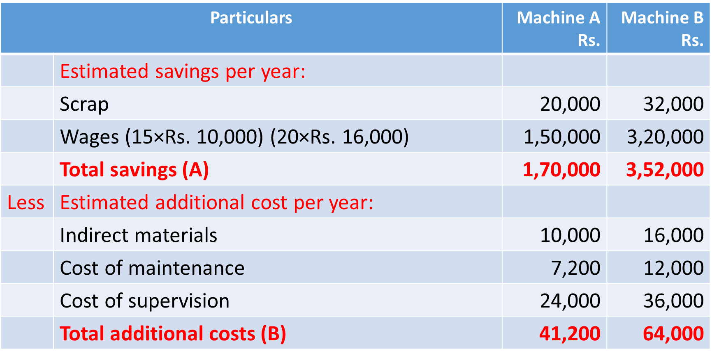
Profitability Statement

Slide 58
 | Profit before depreciation and Tax (A-B) | 1,28,800 | 2,88,000
Less | Depreciation | 50,000 | 63,000
 | Profit before tax | 78,800 | 2,25,000
Less | Tax @ 50% | 39,400 | 1,12,500
 | Profit after tax | 39,400 | 1,12,500
 | Return on investment or ARR = [Average Profit/Original Investment]×100 | [Rs. 39,400/ Rs. 3,50,000]×100 | [Rs.1,12,500/Rs. 6,30,000]×100
 | ARR | 11.26% | 17.85%
Comment: Machine B should be recommended.

Slide 59
12. X limited is considering the purchase of a new machine to replace a machine which has been in operation in the factory for the last 5 years.
Ignoring interest but considering tax at 50% of net earnings, suggest which of the two alternatives should be preferred. The following are the details:
Particulars | Old Machine | New machine
Purchase price | Rs. 40,000 | Rs. 60,000
Estimated life of machine | 10 years | 10 years
Machine running hours p.a. | 2,000 | 2,000
Units per hour | 24 | 36
Wages per running hour (Rs.) | 2 | 5.25
Power p.a. | 2,000 | 4,500

Slide 60
You may assume that the above information regarding sales and coat of sales will hold good throughout the economic life of the machine. Depreciation has to be charged accordingly to SLM. Calculate ARR and to give relevant comment to the management.
Consumable stores p.a. | 6,000 | 7,500
All other charges p.a. | 8,000 | 9,000
Material cost per unit | 0.50 | 0.50
Selling price per unit | 1.25 | 1.25

Slide 61
Solution:
Working Note:
Calculation of No.of units produced:
Units Produced = Running hours × Units per hour
Old machine = 2,000 × 24 = 48,000 units
New machine = 2,000 × 36 = 72,000 units

Slide 62
Profitability Statement
 | Particulars | Old Machine Rs. | New Machine Rs.
 | Estimated Sales (A) [48,000 × 1.25 and 72,000 × 1.25] | 60,000 | 90,000
Less | Cost of sales:
 | Direct materials [48,000×0.50 and 72,000×0.50] | 24,000 | 36,000
 | Wages [2,000×Rs. 3 and 2,000×Rs.5.25] | 6,000 | 10,500
 | Power | 2,000 | 4,500
 | Consumable store | 6,000 | 7,500
 | Other charges | 8,000 | 9,000
 | Deprecation[Rs. 40,000/10 and Rs. 60,000/10] | 4,000 | 6,000
 | Total cost of sales (B) | 50,000 | 73,500

Slide 63
 | Profit before tax (A-B) | 10,000 | 16,500
Less | Tax @ 50% | 5,000 | 8,250
 | Profit after tax | 5,000 | 8,250
 | Return on investment or ARR = [Average Profit/Original Investment]×100 | [5,000/ 40,000]×100 | [8,250/ 60,000]×100
 | ARR | 12.5% | 13.75%
Comment: New machine should be recommended.

Slide 64
B) Discounted Cash flow Techniques:
1. Net Present Value:
The net present value method is one of the modern methods for evaluating project proposals. In this method, cash inflows are considered with the time value of the money. Net present value is described as the summation of the present value of cash inflow and present value of cash outflow. Net present value is the difference between the total present value of future cash inflows and the total present value of future cash outflows.
NPV = Present value of net cash inflow - Total net initial investment
Determining Discount Rate:
Theoretically, the discount rate or desired rate of return on an investment is the rate of return the firm would have earned by investing the same funds in the best available alternative investment that has the same risk.

Slide 65
Many organizations choose to use the overall cost of capital or Weighted Average Cost of Capital (WACC) that an organization has incurred in raising funds or expects to incur in raising the funds needed for an investment.
Merits:
1. It recognizes the time value of money.
2. It considers the total benefits arising out of the proposal.
3. It is the best method for the selection of mutually exclusive projects.
4. It helps to achieve the maximization of shareholders’ wealth.

Slide 66
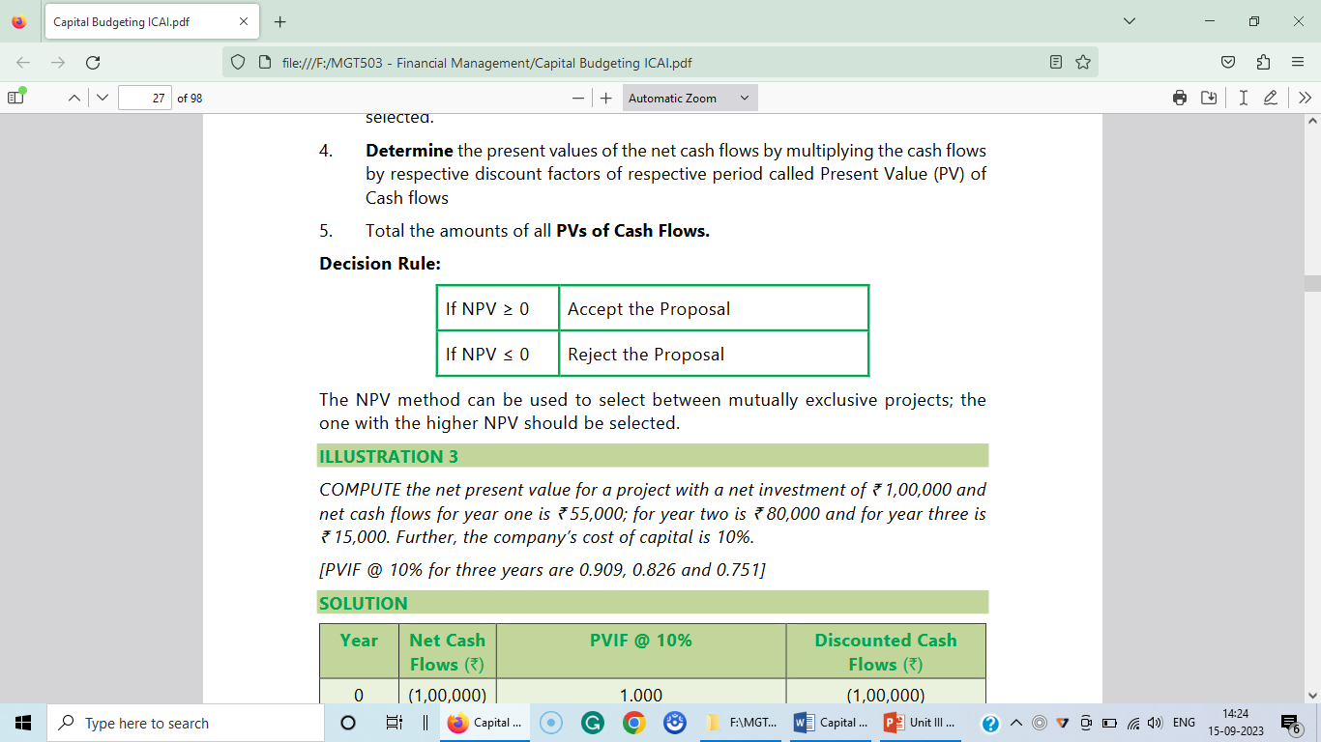
Demerits:
1. It is difficult to understand and calculate.
2. It needs the discount factors for the calculation of present values.
3. It is not suitable for projects having different effective lives.
Accept/Reject criteria:
If the present value of cash inflows is more than the present value of cash outflows, it would be accepted. If not, it would be rejected.
Note: Cash inflow = Net profit after tax + depreciation

Slide 67
Merits: The merits of this method are:
(i) It takes into account the time value of money
(ii) It helps to accept / reject investment proposal on the basis of value of the index.
(iii) It is useful to rank the proposals on the basis of the highest /lowest value of the index.
(iv) It takes into consideration the entire stream of cash flows generated during the life of the asset.
Demerits: However, this technique suffers from the following limitations:
(i) It is somewhat difficult to compute.
(ii) It is difficult to understand the analytical of the decision on the basis of profitability index.

Slide 68
13. An investment of Rs. 10,000 (having scrap value of Rs. 500) yields the following returns:
The cost of capital is 10%. Is the investment desirable? Discuss it according to NPV method.
Year | Cash flows after tax Rs.
1. | 4,000
2. | 4,000
3. | 3,000
4. | 3,000
5. | 2,500

Slide 69
Solution: Statement showing NPV
Year | CFAT Rs. | PV factor at 10% | Present value of cash inflows (Rs.)
1. | 4,000 | 0.909 | 3,636
2. | 4,000 | 0.826 | 3,304
3. | 3,000 | 0.751 | 2,253
4. | 3,000 | 0.683 | 2,049
5. | 2,500 | 0.620 | 1,550
5. (Scrap) | 500 | 0.620 | 310
 | Total Present Value of Cash inflows |  | 13,102
Less | Present value of cash outflow |  | 10,000
 | NPV |  | 3,102
Comment: Since the NPV is positive. Therefore, the investment is positive.

Slide 70
P14. From the following information, calculate the net present value of the two project and suggest which of the two projects should be accepted at the discount rate of 10%.
Particulars | Project X | Project Y
Initial Investment | Rs. 20,000 | Rs. 30,000
Estimated Life | 5 Years | 5 Years
Scrap Value | Rs. 1,000 | Rs. 2,000
Profits before dep. and after taxation (cash inflows) | Rs. | Rs.
Year 1. | 5,000 | 20,000
2. | 10,000 | 10,000
3. | 10,000 | 5,000
4. | 3,000 | 3,000
5. | 2,000 | 2,000

Slide 71
Note : The following are the present value factors @ 10% p.a.
Year | Present value factors @ 10% p.a.
1. | 0.909
2. | 0.826
3. | 0.751
4. | 0.683
5. | 0.621
6. | 0.564

Slide 72
Solution: Computation of NPV
Comment: Project Y should be selected.
Project Y should be selected.
Year | Cash Inflows |  | PV factors @ 10% p.a. | Present Value of Net Cash Inflows
 | Project X (Rs.) | Project Y (Rs.) |  | Project X (Rs.) | Project Y (Rs.)
1. | 5,000 | 20,000 | 0.909 | 4,545 | 18,180
2. | 10,000 | 10,000 | 0.826 | 8,260 | 8,260
3. | 10,000 | 5,000 | 0.751 | 7,510 | 3,755
4. | 3,000 | 3,000 | 0.683 | 2,049 | 2,049
5. | 2,000 | 2,000 | 0.621 | 1,242 | 1,242
5. Scrap | 1,000 | 2,000 | 0.621 | 621 | 1,242
 | Total present value of cash inflows |  |  | 24,227 | 34,728
Less | Initial Investment |  |  | 20,000 | 30,000
 | Net Present Value [NPV] |  |  | 4,227 | 4,728

Slide 73
P15. The following are the cash inflows and outflows of a certain project.
The salvage value at the end of 5 years is Rs. 50,000. Taking the cut-off rate as 10%, calculate net present value.
Years | Outflows (Rs.) | Inflows (Rs.)
0 | 1,75,000 | --
1 | 50,000 | 35,000
2 |  | 45,000
3 |  | 65,000
4 |  | 85,000
5 |  | 50,000

Slide 74
Solution: Computation of NPV
Year | Cash Inflows Rs. | Present Value @ 10% of Cash Inflows | Present Value of Cash Inflows (Rs)
1. | 35,000 | 0.909 | 31,815
2. | 45,000 | 0.826 | 37,170
3. | 65,000 | 0.751 | 48,815
4. | 85,000 | 0.683 | 58,055
5. | 50,000 | 0.621 | 31,050
5. (Salvage) | 50,000 | 0.621 | 31,050
 | Total present value of cash inflows |  | 2,37,955
Less | Cash outflow beginning [Rs. 1,75,000 + Rs. 45,450] Plus Additional capital [Rs. 50,000 × 0.909 = 45,450] |  | 2,20,450
 | Net Present Value [NPV] |  | 17,505
Notes:
2.

Slide 75
P16. National steel company is considering to invest in a project which cost Rs. 2,50,000 and will require an increase in the level of investment and working capital of Rs. 1,25,000 over its life. The project will generate additional sales of Rs. 2,50,000 and will require additional expenses of Rs. 75,000 every year. The project has five years life. The firms cost of capital is 10% and is in the tax bracket of 50%. Assuming straight line method of depreciation, should the project be accepted? Present value of an annuity of Re. 1 at 10% for 5 years is 3.7908.

Slide 76
Solution:
1. Computation of total cash outflow:
2. Computation of annual cash inflow:
 | Particulars | Rs.
 | Cost of new project | 2,50,000
Add | Additional working capital | 1,25,000
 | Total cash outflow | 3,75,000
 | Particulars | Rs.
 | Additional sales | 2,50,000
Less | Additional expenses | 75,000
 |  | 1,75,000

Slide 77

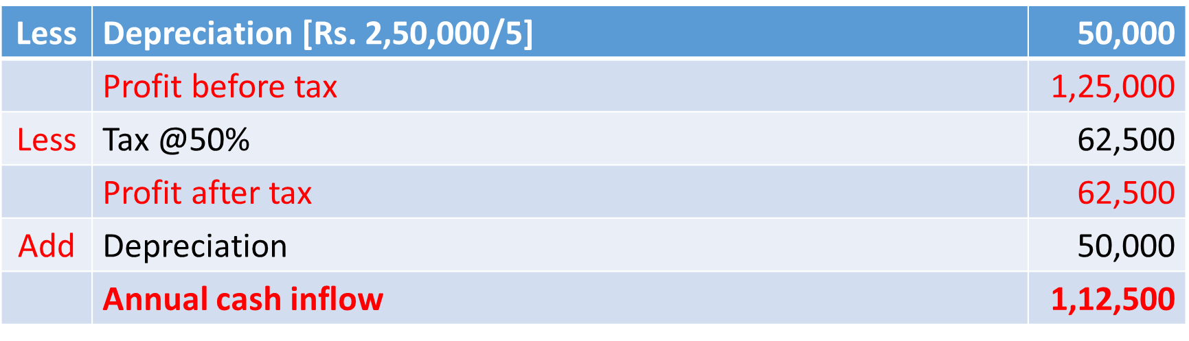
3. Computation of NPV:
 | Particulars | Rs.
 | Present value of cash inflows for 5 years [Rs. 1,12,500 × 3.7908] | 4,26,090
Less | Present value of cash outflow | 3,75,000
 | NPV | 51,090
Comment: The project should be accepted as its NPV is positive.

Slide 78
17. XYZ Ltd. has decided to diversify its production and wants to invest its surplus funds on the most profitable project. It has under consideration only two products A and B. The cost of project A is Rs. 100 lakhs and that of B is Rs. 150 Lakh. Both project are expected to have a life of 8 years only and end of this period, A will have a salvage value of Rs. 4 lakh and B Rs. 14 lakh. The running expenses of A will be Rs. 35 lakh per year and that of B Rs. 20 lakh per year. In either case, the company expects a rate of return of 10%. The company’s tax rate is 50%. Depreciation is charged on straight line basis. Which project should the company take up?
Comment:
Project B should be recommended.

Slide 79
Solution: Statement showing NPV
 | Particulars | Project A Rs. | Project B Rs.
 | Profit after tax @10% of project cost | 10,00,000 | 15,00,000
Add | Depreciation {[Original cost-Scarp value]/No. of years} | 12,00,000 | 17,00,000
 | Cash inflows | 22,00,000 | 32,00,000
 | PV Factor @ 10% for 8 years (refer table) | 5.335 | 5.335
 | PV of value of cash inflows | 1,17,37,000 | 1,70,72,000
Add | PV of salvage @ 10% in 8th year (0.467) | 1,86,800 | 6,53,800
 | Total PV for cash inflows | 1,19,23,800 | 1,77,25,800
Less | PV of cash outflow | 1,00,00,000 | 1,50,00,000
 | NPV | 19,23,800 | 27,25,800

Slide 80
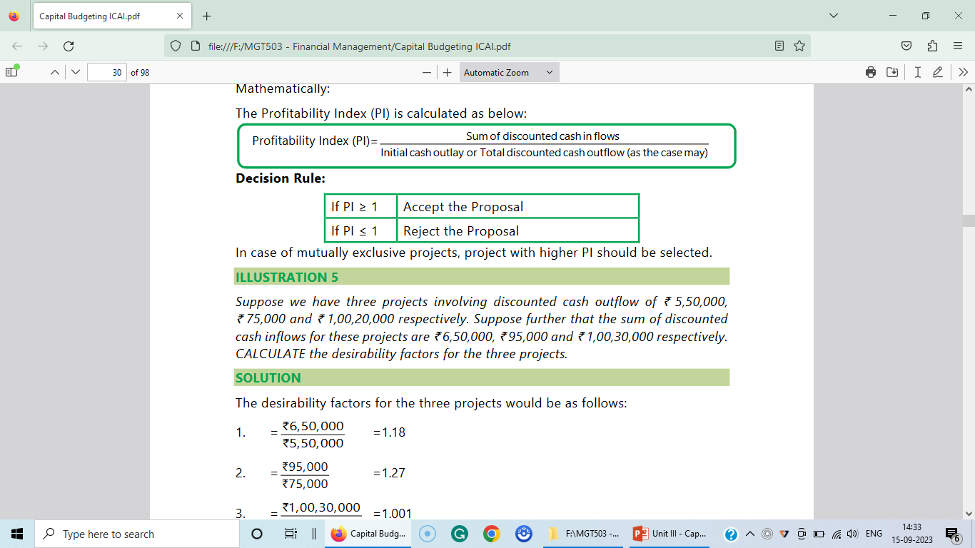
2. Excess Present Value Index Method:
Index Excess present value is calculated on the basis of net present value. It gives the results in percentage. It is calculated as follows:
Excess present value index =
[Total present value of cash inflows/Total present value of cash outflows] × 100
Decision criteria:
If the Profitability Index is greater than or equal to one or 100%, the project should be accepted otherwise reject.

Slide 81
For Problem 14.
Project X = [Rs. 24,277/Rs. 20,000] × 100
= 121.385%
Project Y = [Rs. 34,728/Rs. 30,000] × 100
= 115.76%
Note:
The desirability/ Profitability Index factor helps us in ranking various projects.

Slide 82
3. Internal Rate of Return (IRR):
IRR method follows discounted cash flow technique which takes into account the time value of money. The internal rate of return is the interest rate which equates the present value of expected future cash inflows with the initial capital outlay. In other words, it is the rate at which NPV is equal zero.
Whenever a project report is prepared, IRR is to be worked out in order to ascertain the viability of the project. This is also an important guiding factor to financial institutions and investors.

Slide 83
Steps to be followed:
Step1. find out factor is calculated as follows:
F= Cash outlay (or) initial investment/Cash inflow
Step 2. Find out the positive net present value
Step 3. Find out the negative net present value
Step 4. Find out the net IRR
Formula:
IRR = Lower rate + [Positive NPV/Difference in calculated present value]
× Difference in rate

Slide 84
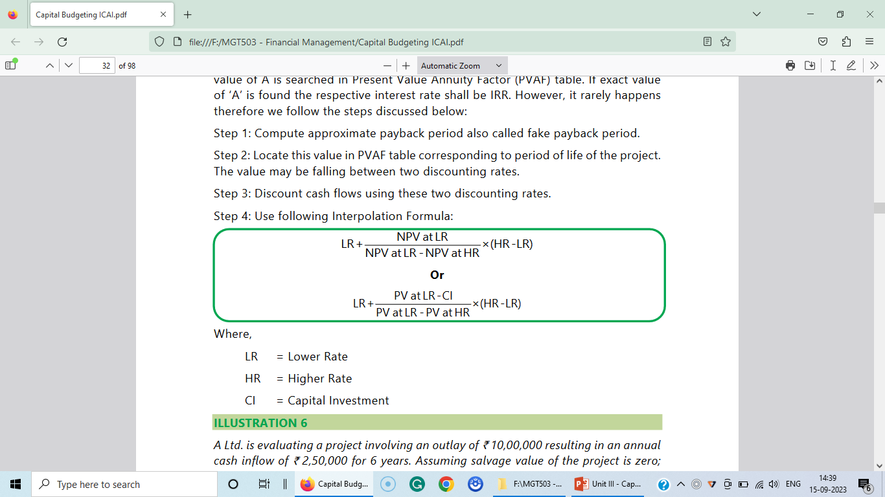
Formula:
Where:
LR = Lower Rate
HR = Higher Rate
CI = Capital Investment

Slide 85
Computation of IRR:
The Internal rate of return is to be determined by trial and error method. The following steps can be used for its computation.
(i) Compute the present value of the cash flows from an investment, by using arbitrary by selected interest rate.
(ii) Then compare the present value so obtained with capital outlay.
(iii) If the present value is higher than the cost, then the present value of inflows is to be determined by using higher rate.
(iv) This procedure is to be continued until the present value of the inflows from the investment are approximately equal to its outflow.
(v) The interest rate that bring about equality is the internal rate if return.

Slide 86
Acceptance Rule:
If the internal rate of return exceeds the required rate of return, then the project will be accepted. If the project‘s IRR is less than the required rate of return, it should be rejected. In case of ranking the proposals the technique of IRR is significantly used. The projects with highest rate of return will be ranked as first compared to the lowest rate of return projects.
Thus, the IRR acceptance rules are:
Accept if IRR > k
Reject if IRR < k
May accept or reject if IRR = k
Where K is the cost of capital.

Slide 87
IRR vs. NPV:
Comparison of both the techniques:
(i) Both techniques use Discounted Cash Flow (DCF) method.
(ii) Both recognize the time value of money.
(iii) Both take into account the cash flows over the entire life of the project.
(iv) Both are consistent with the objective of maximizing the wealth of shareholders.
(v) Both are difficult to calculate.
(vi) Both techniques may often give contradictory result in the case of alternative proposals which are mutually exclusive.

Slide 88
Recommendation:
The NPV method is generally considered to be superior theoretically because:
(i) It is simple to calculate as compared to IRR.
(ii) It does not suffer from the limitation of multiple rates.
(iii) NPV assumes that intermediate cash flows are reinvested at firm‘s cost of
capital.

Slide 89
The reinvestment assumption of NPV is more realistic than IRR method. But
IRR method is favoured by some scholars because:
It is easier to visualize and to interpret as compared to NPV.
(ii) Even in the absence of cost of capital, IRR gives an idea of project‘s
profitability.
Note: Unless the cost of capital is known, NPV cannot be used.
(iii) IRR method is preferable to NPV in the evaluation of risky projects.

Slide 90
P18. Calculate IRR from the following:
 | Rs.
Initial investment | 1,20,000
Life of the assets | 4 years
Estimated net annual cash flows: | Rs.
1st year | 30,000
2nd Year | 40,000
3rd year | 60,000
4th year | 40,000

Slide 91
Solution:
a) PV factor = Initial investment/Average cash inflows
= Rs. 1,20,000 / Rs.42,500
= 2.8235
Calculate present values to 2.8235 from the Annuity Table for 4 years are 2.914 at 14% and 2.855 at 15%. So, IRR can be interpolated by trial and error method using discounted rate of 14% and 15%.

Slide 92
Statement showing NPV:
Year | CFAT Rs. | PV factor @ 14% | Present value of cash inflows Rs. | PV factor @15% | Present value of cash inflows Rs.
1. | 30,000 | 0.877 | 26,310 | 0.869 | 26,070
2. | 40,000 | 0.769 | 30,760 | 0.756 | 30,240
3. | 60,000 | 0.674 | 40,440 | 0.657 | 39,420
4. | 40,000 | 0.592 | 23,680 | 0.571 | 22,840
 | Total present value of cash inflows |  | 1,21,190 |  | 1,18,570
Less | Present value of cash outflow |  | 1,20,000 |  | 1,20,000
 | NPV |  | 1,190 |  | (- 1,430)

Slide 93
In IRR total present value of cash inflows should be equal to present value of cash outflow. Initial investment is Rs. 1,20,000. Hence the IRR must be in between 14% and 15%.
The exact IRR is calculated as follows:,
IRR = Lower rate + [Positive NPV/Difference in calculated present value]
× Difference in rate
= 14% + {1,190/[Rs. 1,21,190 – Rs. 1,18,570]×[15% - 14%]}
= 14% + [Rs. 1,190/Rs. 2,620] × 1%
= 14% + 0.45 × 1%
= 14.45%

Slide 94
4. Modified Internal Rate of Returns (MIRR):
IRR assumes that interim positives cash flows are reinvested at the rate of returns as that of the project that generated them. This is usually an unrealistic scenario. To overcome this draw back a new technique emerges. Under MIRR the earlier cash flows are reinvested at firm‘s rate of return and finding out the terminal value. MIRR is the rate at which present value of terminal values equal to outflow (Investment).

Slide 95
5. Discounted Pay Back Method:
Under this method the discounted cash inflows are calculated and where the discounted cash flows are equal to original investment then the period which is required is called discounting payback period. While calculating discounting cash inflows the firm‘s cost of capital has been used.
Formula:
Discounted payback period (DPP) = Investment / Discounted Annual cash in flow
Decision Criteria:
Out of two projects, selection should be based on the period of discounting payback period (Lesser payback period should be preferred.)

Slide 96
P19. Project A has an initial investment of Rs. 5,00,000. It’s cash inflows for 5 years are Rs. 1,50,000, Rs. 1,80,000, Rs. 1,50,000, Rs. 1,32,000 and Rs. 1,20,000. The cost of capital is 10%. Calculate the Discounted Pay back period.
Solution:
Calculation of Discounted pay back period
Year | Cash inflow Rs. | PV factor @10% | Present value of cash inflow Rs. | Cumulative present value of cash inflows Rs.
1. | 1,50,000 | 0.909 | 1,36,350 | 1,36,350
2. | 1,80,000 | 0.826 | 1,48,680 | 2,85,030
3. | 1,50,000 | 0.751 | 1,12,650 | 3,97,680
4. | 1,32,000 | 0.683 | 90,156 | 4,87,836
5. | 1,20,000 | 0.621 | 74,520 | 5,62356

Slide 97
Pay back period = 4 years + {[Rs. 12,164/Rs.74,520 ] × 12}
= 4 years + 2 months or
= 4 years and 61 days

Slide 98
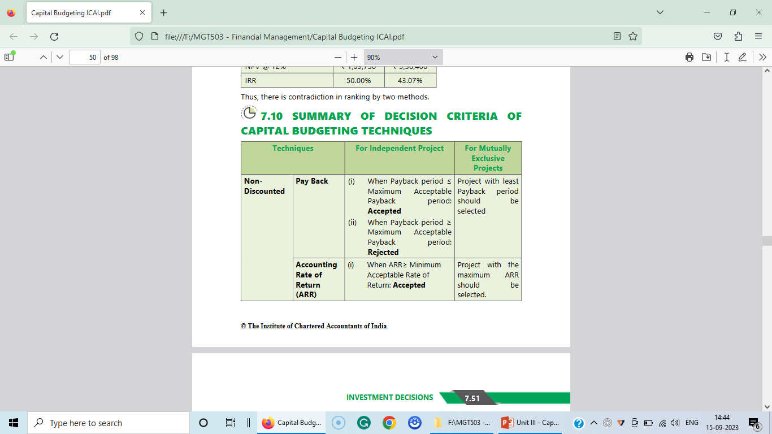
Summary of Decision Criteria of Capital Budgeting Techniques:

Slide 99
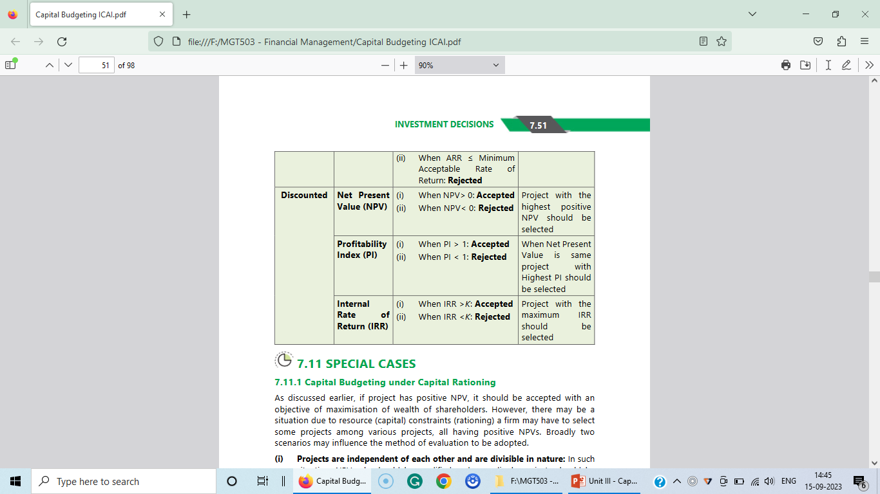

Slide 100
Comprehensive Problem:
P20. X ltd. is considering investing in a project requiring a capital outlay of Rs. 8,00,000. Forecast the annual net income after depreciation before tax are as follows:
Depreciation may be taken as 20% on original investment and taxation at 50% of net income.
Year | Annual net income after depreciation before tax Rs.
1. | 4,00,000
2. | 4,00,000
3. | 3,20,000
4. | 3,20,000
5. | 1,60,000

Slide 101
You are required to evaluate the project according to each of the following methods:
Payback period method,
Return on original investment method,
Return on average investment method,
NPV method @10%,
PI method,
IRR method.

Slide 102
Solution:
Payback period method:
Statement showing Cumulative cash inflow
Note: Depreciation = 8,00,000/5 Years = 1,60,000
Year | Profit before tax Rs. | Less: Tax @50% Rs. | PAT Rs. | Add: Dep Rs. | CFAT Rs. | Cumulative CFAT Rs.
1. | 4,00,000 | 2,00,000 | 2,00,000 | 1,60,000 | 3,60,000 | 3,60,000
2. | 4,00,000 | 2,00,000 | 2,00,000 | 1,60,000 | 3,60,000 | 7,20,000
3. | 3,20,000 | 1,60,000 | 1,60,000 | 1,60,000 | 3,20,000 | 10,40,000
4. | 3,20,000 | 1,60,000 | 1,60,000 | 1,60,000 | 3,20,000 | 13,60,000
5. | 1,60,000 | 80,000 | 80,000 | 1,60,000 | 2,40,000 | 16,00,000

Slide 103
Pay back period = 2 years + {[Rs. 80,000/Rs. 3,20,000] × 12}
= 2 years + 3 months
b) Return on original investment method:
ROI = [Average profit after tax / Original Investment] × 100
= [Rs. 1,60,000/Rs. 8,00,000] × 100
= 20%
c) Return on average investment method:
ROI = [Average profit after tax / Average investment]
= [Rs. 1,60,000 / Rs. 4,00,000] × 100
= 40%

Slide 104
d) Net present value method [NPV]:
Computation of NPV
Year | Cash inflows Rs. | Discount factor @10% | Present value of cash inflows Rs.
1. | 3,60,000 | 0.909 | 3,27,240
2. | 3,60,000 | 0.826 | 2,97,360
3. | 3,20,000 | 0.751 | 2,40,320
4. | 3,20,000 | 0.683 | 2,18,560
5. | 2,40,000 | 0.621 | 1,49,040
 | Total present value of cash inflows |  | 12,32,520
Less | Present value of cash out flow |  | 8,00,000
 | NPV |  | 4,32,520

Slide 105
e) PI Method:
PI = [Total present value of cash inflows/Total present value of cash out flow] × 100
= [Rs. 12,32,520 / Rs. 8,00,000]×100
= 154%
Comment:
The PI of the project is more than that of 100%, and therefore the project can be implemented.

Slide 106
f) IRR Method:
Since the annual cash inflows are not uniform, the factor will have to be located to determine the approximate rate of return.
F = Initial Investment/Average Cash Inflows
= Rs. 8,00,000/Rs. 3,20,000
= 2.5
Table Two discloses this factor rate of return in the column for 5 years as 28%.

Slide 107
The Present value 28% rate.
Computation of NPV
Year | Cash inflows Rs. | Discount factor @28% | Present value of cash in flows Rs.
1. | 3,60,000 | 0.781 | 2,81,160
2. | 3,60,000 | 0.610 | 2,19,600
3. | 3,20,000 | 0.477 | 1,52,640
4. | 3,20,000 | 0.373 | 1,19,360
5. | 2,40,000 | 0.291 | 69,840
 | Total present value of cash inflows |  | 8,42,600
Less | Present value of cash out flow |  | 8,00,000
 | NPV |  | 42,600

Slide 108
At 28% discounting rate, the present value is higher by Rs. 42,600. Hence higher discount rate should be taken. Taking it at 30%.
Computation of NPV
Year | Cash inflows Rs. | Discount factor @30% | Present value of cash in flows Rs.
1. | 3,60,000 | 0.769 | 2,76,840
2. | 3,60,000 | 0.592 | 2,13,120
3. | 3,20,000 | 0.455 | 1,45,600
4. | 3,20,000 | 0.350 | 1,12,000
5. | 2,40,000 | 0.269 | 64,560
 | Total present value of cash inflows |  | 8,12,120
Less | Present value of cash out flow |  | 8,00,000
 | NPV |  | 12,120

Slide 109
The present value at 30%is higher by Rs. 3,030. The IRR will therefore by slightly higher than 30%. Hence the rate may be taken as 30%.

Slide 110
P21. X ltd. Is considering investing in a project requiring a capital outlay of Rs. 2,00,000. Forecast the annual net income after depreciation before tax are as follows:
Depreciation may be taken as 20% on original investment and taxation at 50% of net income.
Year | Annual net income after depreciation before tax Rs.
1. | 1,00,000
2. | 1,00,000
3. | 80,000
4. | 80,000
5. | 40,000

Slide 111
You are required to evaluate the project according to each of the following methods:
Payback period method,
Return on original investment method,
Return on average investment method,
NPV method @10%,
Present Value Index method,
IRR method.

Slide 112
Solution:
Payback period method:
Statement showing Cumulative cash inflow
Note: Depreciation = 2,00,000/5 Years = 40,000
Year | Profit before tax Rs. | Less: Tax @50% Rs. | PAT Rs. | Add: Dep Rs. | CFAT Rs. | Cumulative CFAT Rs.
1. | 1,00,000 | 50,000 | 50,000 | 40,000 | 90,000 | 90,000
2. | 1,00,000 | 50,000 | 50,000 | 40,000 | 90,000 | 1,80,000
3. | 80,000 | 40,000 | 40,000 | 40,000 | 80,000 | 2,60,000
4. | 80,000 | 40,000 | 40,000 | 40,000 | 80,000 | 3,40,000
5. | 40,000 | 20,000 | 20,000 | 40,000 | 60,000 | 4,00,000

Slide 113
Payback period = 2 years + {[Rs. 20,000/Rs. 80,000] × 12}
= 2 years + 3 months
b) Return on original investment method:
ROI = [Average profit after tax / Original Investment] × 100
= [Rs. 40,000/Rs. 2,00,000] × 100
= 20%
c) Return on average investment method:
ROI = [Average profit after tax / Average investment]
= [Rs. 40,000 / Rs. 1,00,000] × 100
= 40%

Slide 114
d) Net present value method [NPV]:
Computation of NPV
Year | Cash inflows Rs. | Discount factor @10% | Present value of cash inflows Rs.
1. | 90,000 | 0.909 | 81,810
2. | 90,000 | 0.826 | 74,340
3. | 80,000 | 0.751 | 60,080
4. | 80,000 | 0.683 | 54,640
5. | 60,000 | 0.621 | 37,260
 | Total present value of cash inflows |  | 3,08,130
Less | Present value of cash out flow |  | 2,00,000
 | NPV |  | 1,08,130

Slide 115
e) PI Method:
PI = [Total present value of cash inflows/Total present value of cash outflow] × 100
= [Rs. 3,08,130 / Rs. 2,00,000]×100
= 154%
Comment:
The PI of the project is more than 100%, and therefore the project can be implemented.

Slide 116
f) IRR Method:
Since the annual cash inflows are not uniform, the factor will have to be located for determining the approximate rate of return.
F = Initial Investment/Average Cash Inflows
= Rs. 2,00,000/Rs. 80,000
= 2.5
Table Two discloses at this factor rate of return in the column for 5 years as 28%.

Slide 117
The Present value 28% rate.
Computation of NPV
Year | Cash inflows Rs. | Discount factor @28% | Present value of cash in flows Rs.
1. | 90,000 | 0.781 | 70,290
2. | 90,000 | 0.610 | 54,900
3. | 80,000 | 0.477 | 38,160
4. | 80,000 | 0.373 | 29,840
5. | 60,000 | 0.291 | 17,460
 | Total present value of cash inflows |  | 2,10,650
Less | Present value of cash out flow |  | 2,00,000
 | NPV |  | 10,650

Slide 118
At 28% discounting rate, the present value is higher by Rs. 10,650. Hence higher discount rate should be taken. Taking it at 30%.
Computation of NPV
Year | Cash inflows Rs. | Discount factor @30% | Present value of cash in flows Rs.
1. | 90,000 | 0.769 | 69,210
2. | 90,000 | 0.592 | 53,280
3. | 80,000 | 0.455 | 36,400
4. | 80,000 | 0.350 | 28,000
5. | 60,000 | 0.269 | 16,140
 | Total present value of cash inflows |  | 2,03,030
Less | Present value of cash out flow |  | 2,00,000
 | NPV |  | 3,030

Slide 119
The present value at 30% is higher by Rs. 3,030. The IRR will therefore by slightly higher than 30%. Hence the rate may be taken as 30%.

Slide 120
Thank You

